Slide 1
2nd ESSF EDUCATIONAL GAMES
OPEN / INCLUSIVE / U18
OLYMPIA & ATHENS – GREECE
30 March - 05 April 2025
BULLETIN 1

Slide 2
INTRODUCTION
Dear ESSF and ISF Europe Members,
Dear Participants,
I’m proud to represent the European School Sports Federation (ESSF), an organization dedicated to promoting school sports across Europe.
Our mission is to inspire and empower you by providing opportunities to engage in competitive sports, fostering values such as teamwork, respect, and fair play.
ESSF is making efforts to organize a variety of events and competitions that bring together students from diverse backgrounds, encouraging not only your athletic excellence but also your personal growth and cultural exchange.
Through our initiatives, we aim to enhance your educational experience, emphasizing the importance of physical activity, healthy lifestyles, and lifelong friendships.
I invite each of you to join us as we continue to champion the spirit of school sports and create unforgettable experiences for the youth of Europe! Your energy and enthusiasm are what make this journey truly special. Let’s make it unforgettable together!
Željko Tanasković,
ESSF President

Slide 3
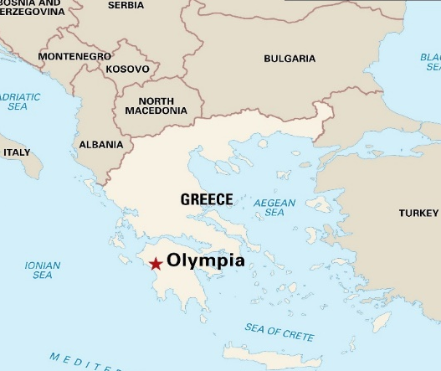
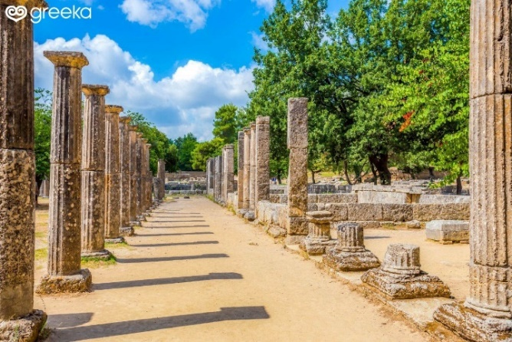
ABOUT OLYMPIA
OLYMPIA IN SHORT
GEOGRAPHICAL POSITION
The archaeological site of Olympia, on the western side of Peloponnese, is famous worldwide as the birth place of the Olympism and the venue of the ancient Olympic Games. These were actually athletic events taking place every four years as part of celebrations for god Zeus. Today, the site hosts the remains of ancient Temples, the Ancient Stadium and the Archaeological Museum. This museum hosts stunning pieces found at excavations in the ancient site and the region of Olympia, such as the Statue of Hermes of Praxiteles and the Nike of Paionios. The Ancient Stadium with the characteristic arch is a global sport and cultural heritage, sited in Olympia.
Olympia lies in the valley of the Alfeiós River (Romanized as Alpheus) in the western part of the Peloponnese, today around 18 km away from the Ionian Sea but perhaps, in antiquity, half that distance. The Altis, as the sanctuary as was originally known, was an irregular quadrangular area more than 180 meters on each side and walled except to the North where it was bounded by the Mount Kronos.
CLIMATE
In Olympia, the weather is balanced and mild all year around. With the beginning of April, Olympia's average high-temperature lies around to a comfortable 20°C and an average low-temperature of 9°C.

Slide 4
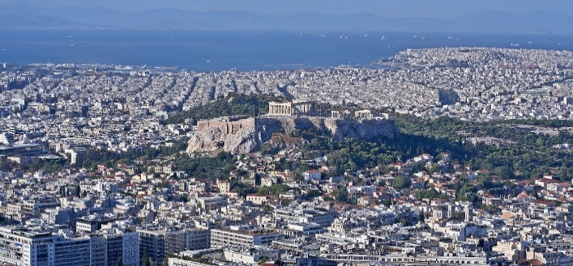
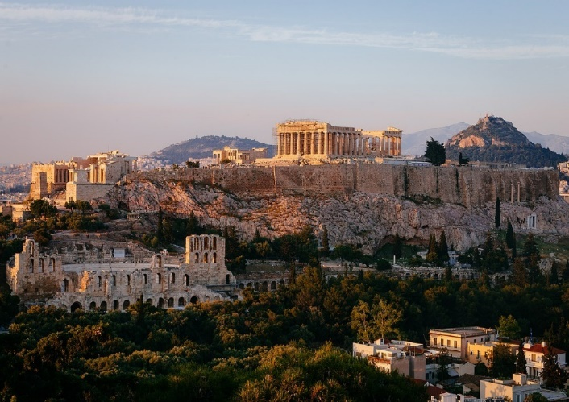
ABOUT ATHENS
ATHENS IN SHORT
GEOGRAPHICAL POSITION
Athens is a major coastal urban area in the Mediterranean, and it is both the capital and the largest city of Greece. With its urban area's population numbering over four million, it is also the eighth largest urban area in the European Union. Athens dominates and is the capital of the Attica region and is one of the world`s oldest cities, with its recorded history spanning over 3,400 years, and its earliest human presence beginning somewhere between the 11th and 7th millennia BC. The city was named after Athena, the ancient Greek goddess of wisdom.
Athens is located on a peninsula that stretches southeastward into the Aegean Sea. The city is surrounded by the Plain of Attica, which in turn is surrounded on three sides by mountains. The city proper covers an area of 15 square miles (39 square kilometers)
CLIMATE
The average temperature in April is 16°C, made up of highs of 20°C and lows of 12°C.

Slide 5
MANAGEMENT
Local Organising Committee
Union of the Graduates of Physical Education – PEPFA
LOC President: Dimitris Grigoriadis
dgrigoriadis7@gmail.com
+306 977716253
ESSF DELEGATE
Gorica Bilak-Moconja, ESSF Sports Director
info@europeanschoolsport.com
PROVISIONAL PROGRAM
DATE PROVISIONAL ACTIVITY
Sunday, 30 March 2025 | Arrivals, Travel to Ancient Olympia (http://www.olympia-greece.org/) Accreditation and Housing of delegations
Monday, 31 March 2025 | Meeting of the Heads of Delegations Visit and Educational Tour at Ancient Olympia (Ancient Stadium, Olympic & Archaeological Museums) WORKSHOP 1
Tuesday, 01 April 2025 | ANCIENT STADIUM WORKSHOP 2
Wednesday, 02 April 2025 | Sporting event in Ancient Olympic Stadium (Stadium Run / Olympic Wreath Ceremony) Travel to Athens / Housing of Delegations at Hotel Opening Ceremony
Thursday, 03 April 2025 | Athens Archaeological Area – City Centre -ACROPOLIS/PARTHENON guided tour -Panathenaic Stadium guided tour and Sport event Free time in Athens Centre NATIONS NIGHT GALA DINNER (Location TBD)
Friday, 04 April 2025 | Sport events at GERAKAS MUNICIPALITY SPORT CENTER (Unified Basketball 3x3) WORKSHOP 4 Prize Giving and (Closing) Ceremony (GERAKAS MUNICIPALITY – TBC) Farewell Party (Location TBD)
Saturday, 05 April 2025 | Departure of delegations
*Please note, that the official program may be subject to change. Any relevant changes will be communicated to the registered delegations prior to the event.

Slide 6
TRAVELLING AND VISA
PORT OF ENTRY
The official port of entry:
International Athens Airport “Eleftherios Venizelos”
TRAVELING
Travel to the official port of entry is to be arranged and financed by each participating delegation. Delegations are to arrive on March 30, 2025 and depart on April 05, 2025 after breakfast. The organisation of an extended stay for the delegation (before or after the event) is a matter of the delegation concerned. It shall not be the responsibility of the Local Organizing Committee (LOC).
LOC will ensure a transportation from port of entry to Olympia & Athens.
VISA
Each participating delegation is required to check whether a visa is needed to enter Greece. Please contact the Embassy or Consulate of Hellenic Republic, at your country, to consult visa application procedure.
For any request of invitation letters or any queries over VISA, please contact:
dgrigoriadis7@gmail.com
More information you can find by following the links below:
https://www.mfa.gr/en/services/
https://www.mfa.gr/en/visas/
INSURANCE
Each participating delegation is required to provide insurance for each member of the delegation. At a minimum, the insurance is to cover civil liability, material damage and medical costs.

Slide 7
EVENT SPECIFICS
Team format
School teams/Special Olympics teams (mixed teams allowed)
Gender Category
Boys / Girls
Age category
U18: Students aged 16, 17 and 18 on the last day of competition (students born in 2006*-2007-2008-2009).
*If born in 2006, student must be 18 years old on the last day of the event.
Team format
School team: a team formed by students enrolled in schools of the country which they represent.
Special Olympics team: a team formed by Special Olympics students enrolled in schools at the country which they represent.
Mixed “School” and “Special Olympics” teams are also allowed.
Maximum teams per delegation
Each delegation may enter more than 1 team per gender category.
Participation
This event is open for participation to:
ESSF members: Schools Sport Entities recognized as such by the General Assembly and in order with their rights and obligations;
Non-ESSF members: highest institution responsible for school sport recognized by the government of a country that is not member of ESSF;
Special Olympics entities: national institutions or local entities cultivating “Special Olympics” sports
Directly applying schools (DAS) can either be
A school affiliated and registered through an ESSF member (under the approval of the ESSF Member)
A school affiliated to a non ESSF member / self-registered

Slide 8
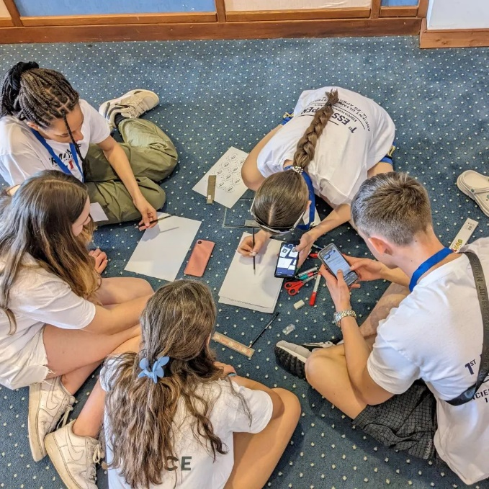
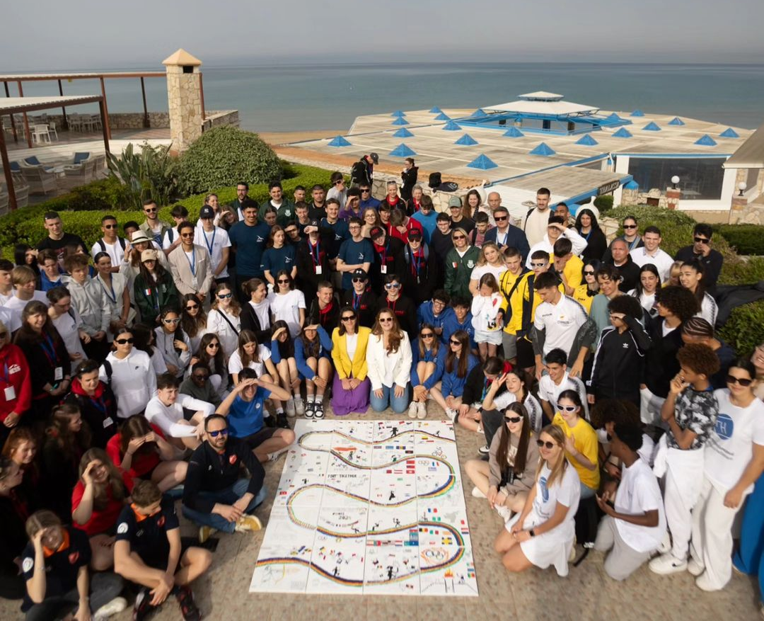
Services Availability
In case of registrations from a big number of teams or participants, which could create any kind of problems at services quality and/or availability to the LOC, the criteria for the final selection are:
Deposit payment - registrations that paid the required deposit / priority VS ALL Below (following the respective deadlines for registration 1, registration 2 etc.)
ESSF Members / priority VS ALL Below
Directly applying teams (DAT) / priority VS ALL Below
Non-ESSF Members / priority VS ALL Below
Number of registrations per country / priority to more countries rather than more delegations from the same country / To Be Decided by LOC
Multiple registrations from the same country / To Be Decided by LOC

Slide 9
COMPOSITION OF THE DELEGATION
Each registering delegation can enter:
UNLIMITED NUMBER OF TEAMS
Participants according to number of registered teams / per country EXAMPLE
Team Officials
Head of
Delegation
Student Athletes
Additional
Adults
Coaches
Other team officials
(min - max) (min - max) (min - max) (min - max) (example)
1
8-12
1 - 2
0 - 2
0 - 2
2
20-24
2 - 4
0 - 4
0 - 2
3
30-36
3- 4
0 - 6
0 - 4
4
40-48
4 - 8
0 - 8
0 - 4

Slide 10
COMPOSITION OF THE DELEGATION
Head of delegation - mandatory;
Student athletes - mandatory;
Team official(s)
Coaches - mandatory;
Other team officials - optional;
Additional adults - optional;
NOTE:
Any other person not specified during registration or exceeding the quotas specified in this document will not be considered part of the official delegation and will not be accredited by the LOC.
HEAD OF DELEGATION
There is a mandatory number of one (1) head of delegation per register delegation.
The head of delegation shall be the sole intermediary between the delegation and the Local Organising Committee, and the ESSF Delegate.
He/she may not combine the function with any other official role (coach, referee, etc.).
STUDENT ATHLETES
Each team shall be composed of minimum eight (8) to maximum twelve (12) student athletes.
The following students may take part in the ESSF events as part of the team :
The students are enrolled as full-time students at a school in the country in which they represent.
The student-athletes must be attending schools that provide general education and/or vocational education incorporating segments of general education.
Only the students registered on the team list that was handed in at accreditation are authorized to take part in this competition.
The following are not eligible to participate:
Attendees of vocational schools only attend school as a complement to their vocational training and are not full-time students with a segment of general education.
Students enrolled at schools that provide sports training without any general education.

Slide 11
TEAM OFFICIALS (COACHES AND OTHER TEAM OFFICIALS)
TEACHER-COACH
Each team, shall be register a minimum of one (1) and a maximum of two (2) teachers-coaches.
The teacher-coach trains and guides the team in the competition.
OTHER TEAM OFFICIALS
Each team can enter (optional) maximum 2 other team officials.
The function of each other team officials must be specified during the registration process (Doctor, Physiotherapist, Trainer, Statistician, Team manager etc.).
ADDITIONAL ADULTS
Delegations can register unlimited number of additional adults.
The function of each additional adult must be specified during the registration process (interpreter, security personnel, ministry representative, media, parents, etc.).
PARTICIPANTS OBLIGATIONS
Each participant is required to be present throughout the whole duration of the event.
Each participant is obliged to take part also in all of the non-sport activities.
Each team undertakes to participate together with all other participating teams.
Each participant undertakes to participate together with all other participants.
The absence of any member of a participating team from any part of the entire sport programme, opening-, prize-giving- and closing ceremonies and sociocultural programme may result in the team being excluded from the results.

Slide 12
TECHNICAL RULES
All activities will be unified. Workshops groups and sport activities teams will be mixed. The groups/teams will be composed by random selection from schools and Special Olympic teams’ pupils. Boys and Girls, of various nationalities, will randomly participate at the same group/team.
Entries per event MIXED GROUPS/TEAMS GENERAL RULES
The students may be from the same school or from different schools. As the event focuses on education and culture, students can be selected from any kind of sport, but they should have special merits in school sport in the country concerned
Each country may additionally enter one or more delegations composed of pupils with intellectual disability (Special Olympics Teams). Mixed Teams can also be formed.
Neither older nor younger student will be accepted, unless for the Special Olympics Teams where exceptions can be requested. PRIZE-GIVING Each participant will receive a commemorative certificate. As it is an “Education through Sport” event, no medals will be presented. INFO DESK There will be an Info Desk within the lobby of the hotels.

Slide 13
REGISTRATION
How to register
All members/schools who intend to participate in the event should fill in a registration form, which can be found enclosed to Bulletin 1. All application to be sent to the email: info@europeanschoolsport.com .
The registration process is divided into 2 phases:
November 30, 2024 Opening of registration phase 1
January 20, 2025 Closing of registration phase 1/ Payment of deposits
January 21, 2025 Opening of registration phase 2
January 21 – March 20, 2025 New entries under the approval of LOC
March 20, 2025 Closing of registration phase 2 / Payment of final balance
Phase 1
November 30, 2024 – January 20, 2025 *deposit payment
During registration phase 1 registering delegations shall indicate their intention of participation and the number of teams/participants per category that they wish to enter. NOTE: When registering, Registration Form must be confirmed by National School Sport Federation of other legal entity recognized by ESSF.
Phase 2
January 21, 2025 – March 20, 2025
Registration phase 2 will only be opened after the *deposit has been paid or an agreement with the LOC has been reached. During Phase 2 registration, countries shall enter the exact detailed information for each participant (name, date of birth, gender photo, dietary requirements, referee certificate). In addition, submitting the travel plan is required. Registration form 2 will be sent on delegation e-mail after deposit payment. From January 21 up to March 20 new entries (phase 1) are possible under the approval of LOC .

Slide 14
FINANCIAL CONDITIONS
To participate, each Delegation is required to make two (2) payments:
Deposit payment
Balance fee payment
DEPOSIT PAYMENT
Along with the entry and in order to have access to registration phase 2, participating coutry will need to pay a deposit of 100€ per participant entered in Phase 1.
Please note that the participation to the event is granted only by the deposit payment.
Deadline of deposit payment:
January 20, 2025 (23:59 CET)
The sum will be deducted from the total participation cost.
The deposit must be sent as a single payment for the whole delegation by the organisation responsible for school sport (federation, trust, ministry…).
The deposit is non-refundable in the event of non-participation.
The deposit for the registered teams per category shall be paid by January 20, 2025 (23:59 CET)
If the deposit is not paid within the given deadline, the registrations will not be considered valid and the team will be automatically deleted.
Note : IF agreement with the LOC has been reached, delegations can make payment in total in cash upon arrival.
Deposit shall be paid by bank transfer to the to the following account (all bank charges are to be met by the participating country).
Name of bank: ALPHA BANK
Address: 14 Protopappa Av., 16343, Ilioupolis
BIC (Swift Code) : CRBAGRAA
Payee: PANELLINIA ENOSI PTYXIOUXON
IBAN: GR8701404630463002001000017
Reference: ESSF Educational Games 2025 + name of participating Delegation + Country

Slide 15
2. BALANCE FEE PAYMENT
The balance fee payment is the participation fee minus the deposit which has already been paid.
The balance fee payment is to be paid before the start of the event to the LOC account (all bank charges are to be met by the participating country).
PARTICIPATION FEE
The participation fee covers full board accommodation for the duration of the event plus competition, cultural programme activities and all local transport from the arrival to the official port of entry to the departure of the team.
The participation fee is composed of:
Rates by night: minimum 60€/night/delegation member
ESSF levy: 40€ per delegation member (ESSF member) or 100€ per delegation member (non ESSF member)
RATES BY NIGHT
Team member | Occupancy | **** hotel (APPLIES FOR THE ESSF EDU GAMES 2025)
Head of Delegation | Single occupancy | 80€
Coach | Double occupancy | 80€
 | Single occupancy | 160€
Athlete | 2-4 bedded rooms | 80€
Additional adult | Double occupancy | 80€
 | Single occupancy | 160€
Other Team official | Double occupancy | 80€
 | Single occupancy | 160€
Field of Play official | Double occupancy | 80€
 | Single occupancy | 160€
No. Nights |  | Rate by night (min) |  | ESSF levy |  | Total (minimum/participant)
6 | x | 80€ | + | 40€ | = | 520 €

Slide 16
INSURANCE
Each country is required to provide insurance for each member of its delegation. At a minimum the insurance is to cover civil liability, material damage and medical costs.
GALA DINNER
A gala dinner is organised during the event. All Heads of Delegation are expected to take part in the dinner. The gala dinner fee is 50€/person, to be paid together with the final balance.
The balance fee payment (full payment) is to be paid before the start of the event to the following account (all bank charges are to be met by the participating country).
Payments Deadlines Summary
January 20, 2025 (23:59CET)
Deposit Payment
Before the start of the event, by bank transfer, or cash on arrival the LOC
Final Balance

Slide 17
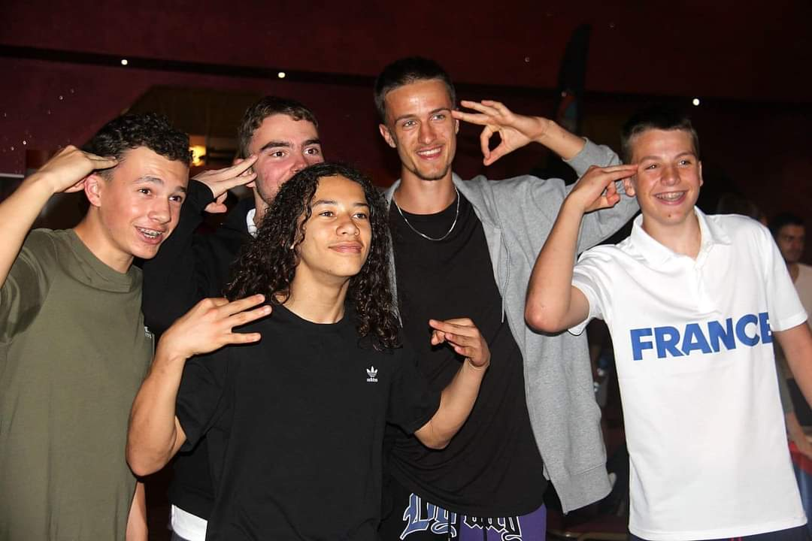
LOGISTICS
ARRIVAL & DEPARTURE
Delegations will be welcomed at the terminal of the airport with the following sign of ESSF:
Transportation will be provided until the accreditation centre, situated in the hotels.
TRANSPORT NETWORK
The LOC guarantees a precise transporation system for all accredited people by buses. This transportation network will cover travel from hotels to sport venues and vice versa.
As food halls will be situated in the hotels, they will be served by the same transportation network.
ACCOMMODATION
The hotel rooms will be fitted in various sizes, including:
Single-bed rooms
Double-bed rooms
Triple-bed rooms
Four-bed rooms

Slide 18
NON-SPORT ACTIVITIES
OPENING CEREMONY
The opening ceremony will take place on 02/04. The ceremony will be indoors.
CULTURAL DAY PROGRAMME
Cultural day will be held on 03/04 at Athens Acropolis and Panathenaic Stadium, the venue of the 1st Modern Olympic Games on 1896. Transportation from hotel to the sites will be by buses. Participants will be divided into groups and each group will have a guided tour to the sites.
“NATION’S NIGHT”
Nation`s night will be held on 03/04 at the Athens hotel facilities.
Delegations are required to take part in an activity named “Nation’s Night” organised with the aim of encouraging exchanges between the different cultures of participating countries.
The young people are invited to introduce and to promote their countries and their culture in an original way.
Each delegation is to organise a stand that promotes their country’s specialties in terms of art crafts, visual materials, food, drinks (no alcohol), pins, leaflet, etc.
In addition, each delegation shall introduce a facet of its country’s.
GALA DINNER
The Gala dinner will take place on 03/04 at 20.00. Location will be provided by LOC.
CLOSING CEREMONY
Closing ceremony and prize giving will be held on 04 April 2025.

Slide 19
MEDICAL/other information
FOOD & BEVERAGE
Food will be supplied by the hotels and will be served at the hotel dining halls.
The food menu will be based on the necessary nutriments for athletes.
Although tap water will be perfectly fine to drink, each team will receive water
bidons; bottled water will also be provided for all accredited persons during meals
and at event venues.
The LOC will accommodate specific diet and food restrictions, which will be specified following Phase 2 registration for participants.
HOSPITALS
Medical care will be provided to all accredited persons;
there will be doctors with medical equipment present
at every field of play.
GENERAL INFORMATION
Listed are relevant information regarding Greece:
General information on country
- Language: Greek/English
- Currency: EUR
- Weather: Mediterranean climate
- Temperature in April: 10° - 20° Celsius
- Electrical socket: The electric socket used is
the European CEE7/7 "Shuko" wall outlet
- Tap water is drinkable
Accredited persons will receive 3 meals per day:
• Breakfast
• Lunch
• Dinner
MEDIA AND COMMUNICATION
We would love for you to help us support the young athletes participating at ESSF events.
Follow the official Instagram page/and other social networks
Use the official ESSF hashtags
Follow news on ESSF’s website
Share ESSF content on your national federation’s profile

Slide 20
MEDIA AND COMMUNICATION
Contact information: info@europeanschoolsport.com
The official results and information can be found at: https://europeanschoolsport.com/
SOCIAL MEDIA GUIDELINES
Spread the word on ESSF European Educational Games Open /Inclusive/ U18
The official Instagram page: @ESSFSPORTS
Use the official event hashtags: #EDUGames
Follow news on websites:
https://europeanschoolsport.com/
Looking forward to meeting you in Olympia & Athens
on 30 March – 05 April 2025!
@ESSFSPORTS
@ESSF

